Slide 1
TOPIC:EDUSAKAHA - VIDEO EVENTS
Team: Team 206++
-Dharma Bagadia
-Anmol Chauhan
-Vatsal Jajadiya
-Nirmal Chaudhary

Slide 2
FEATURES THAT WILL TURN EVERY SESSION INTO A CAPTIVATING EXPERIENCE THAT WILL LEAVE YOUR AUDIENCE SPELLBOUND AND COMING BACK FOR MORE."
Audience Engagement Games: Here we will develop interactive games or quizzes that attendees can participate in during the event, promoting engagement and knowledge retention.
Virtual Swag Bags: Here this feature will provide attendees with a virtual "swag bag" filled with digital goodies like e-books, discounts, and resources from event sponsors.

Slide 3
TOOLS AND TECHNLOGIES
Node.js
Express.js
React.js
scoket.io
MonogoDB

Slide 4
HOW MUCH WORK IS IMPLEMENTED TILL PRESENT
User Authentication.
Conducting a video Event and sharing it
Event Registration
Event History
Text-based Q&A for interactive engagement.

Slide 5
WHAT WE ARE PRESENTLY WORKING ON
Automated email confirmation upon registration.
Integrated live video streaming for webinars and real-time campus tours.
Key Features:
1) Audience Engagement Games
2) Virtual Swag Bags

Slide 6
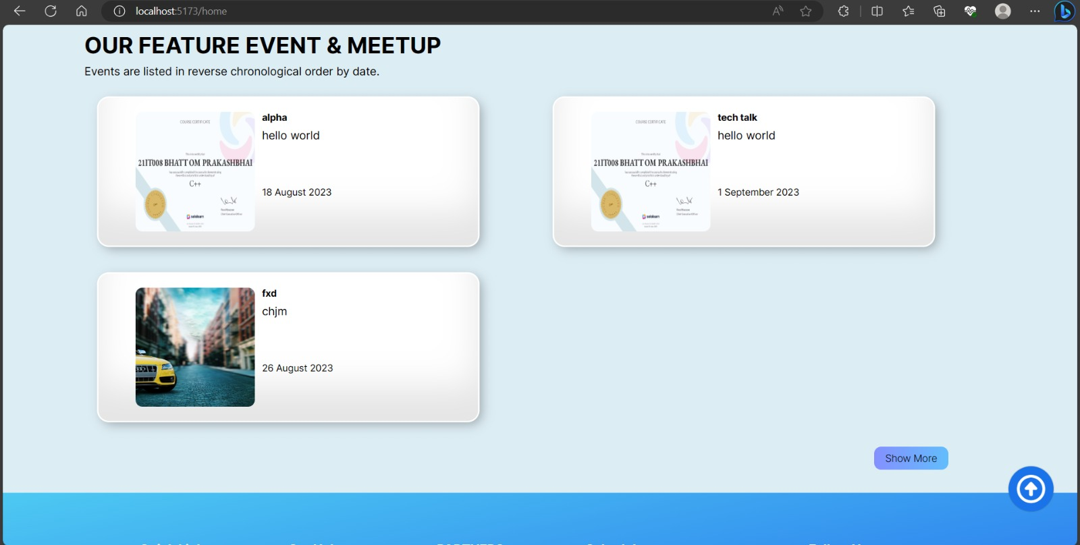
SCREENSHOTS

Slide 7
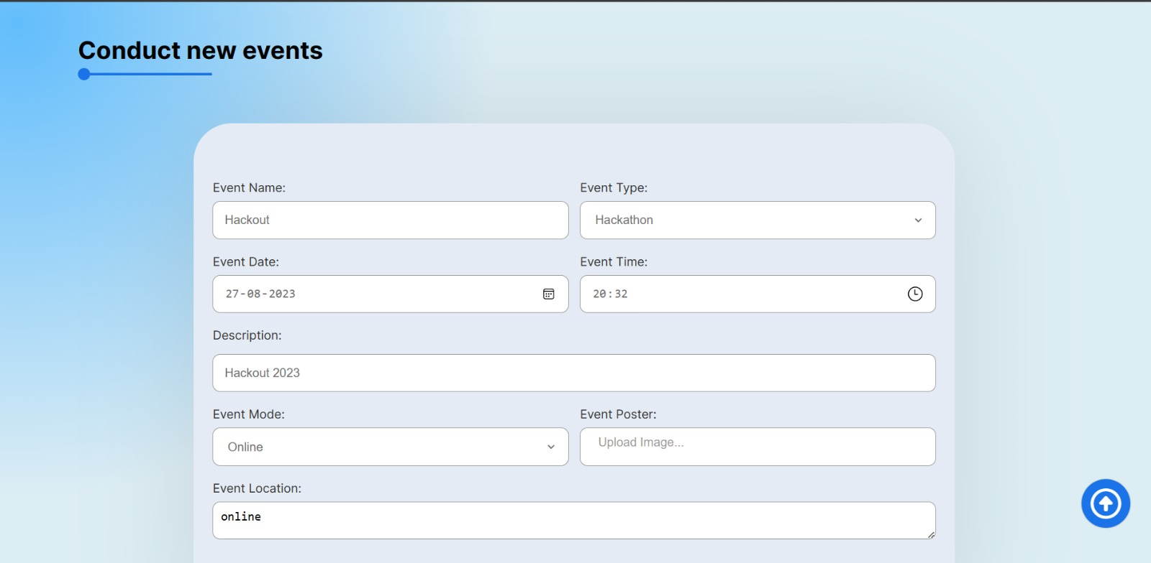
SCREENSHOTS

Slide 8
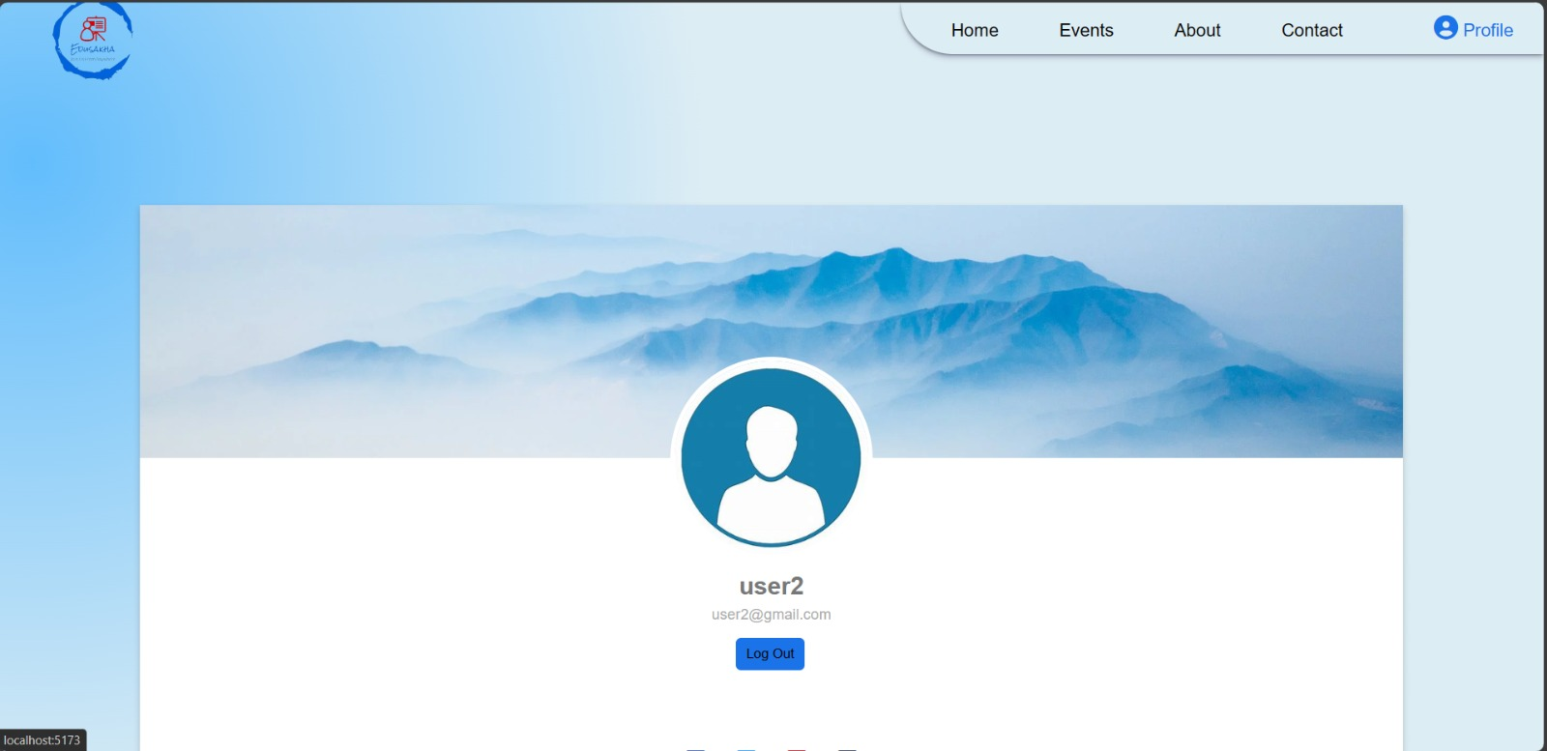
SCREENSHOTS

Slide 9
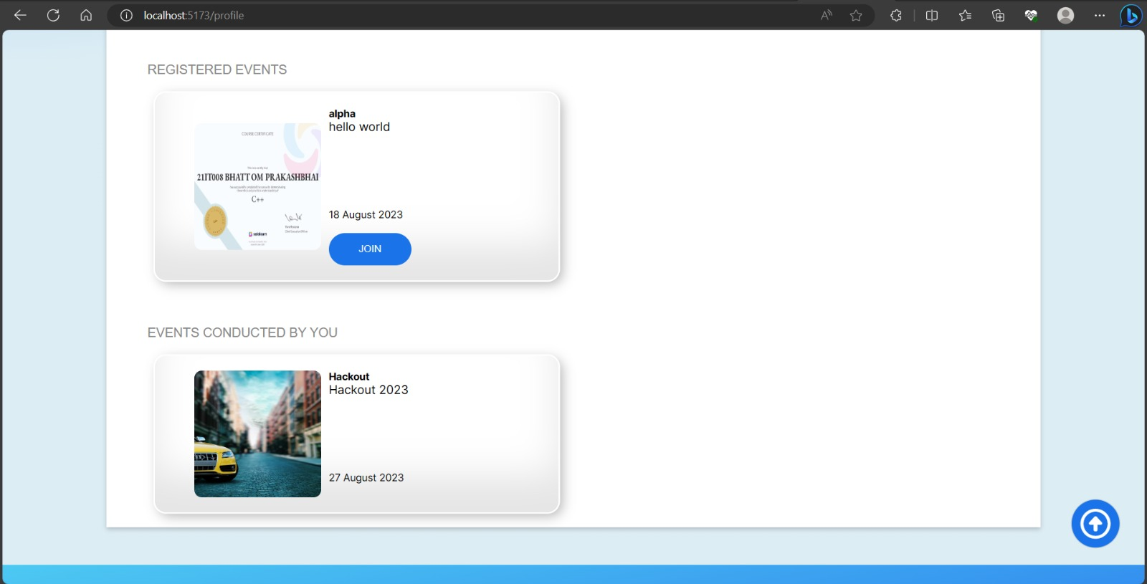
SCREENSHOTS

Slide 10
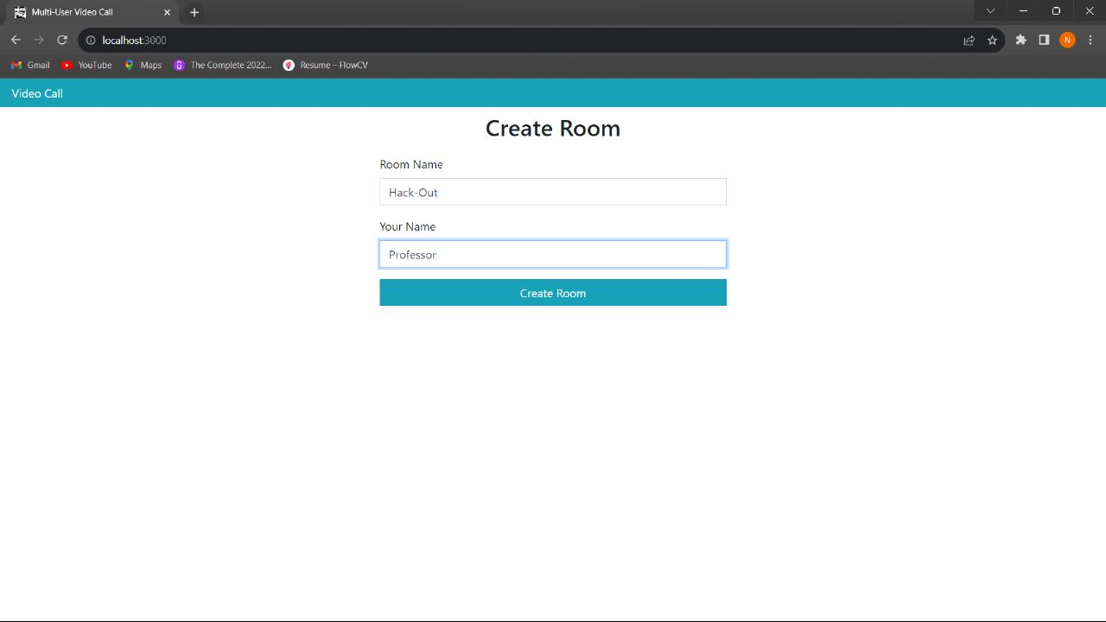
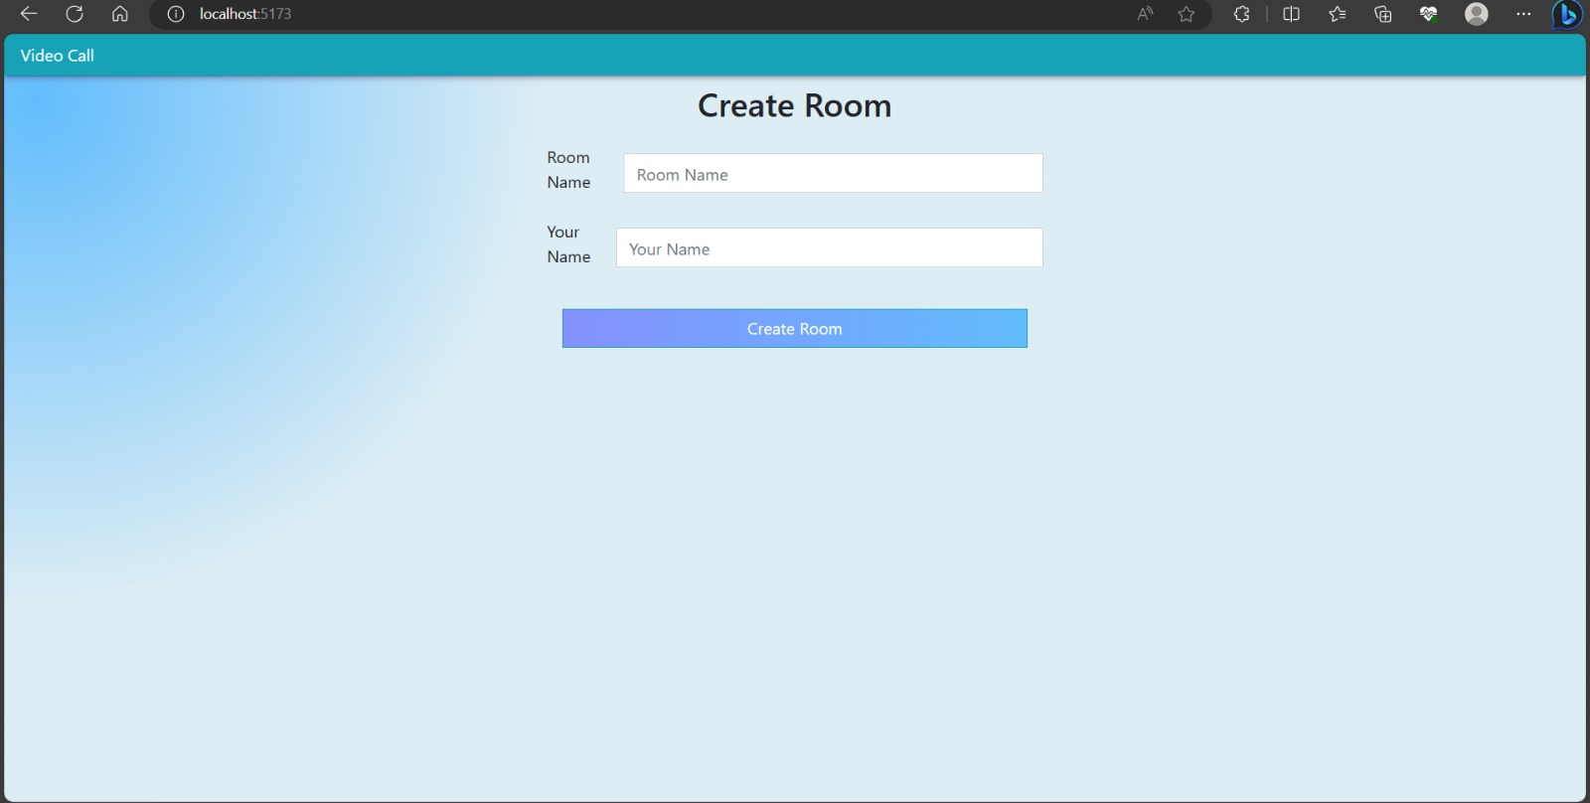
SCREENSHOTS

Slide 11
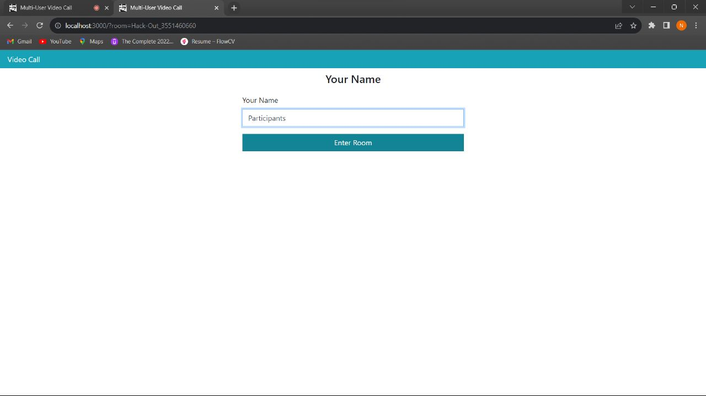
SCREENSHOTS

Slide 12
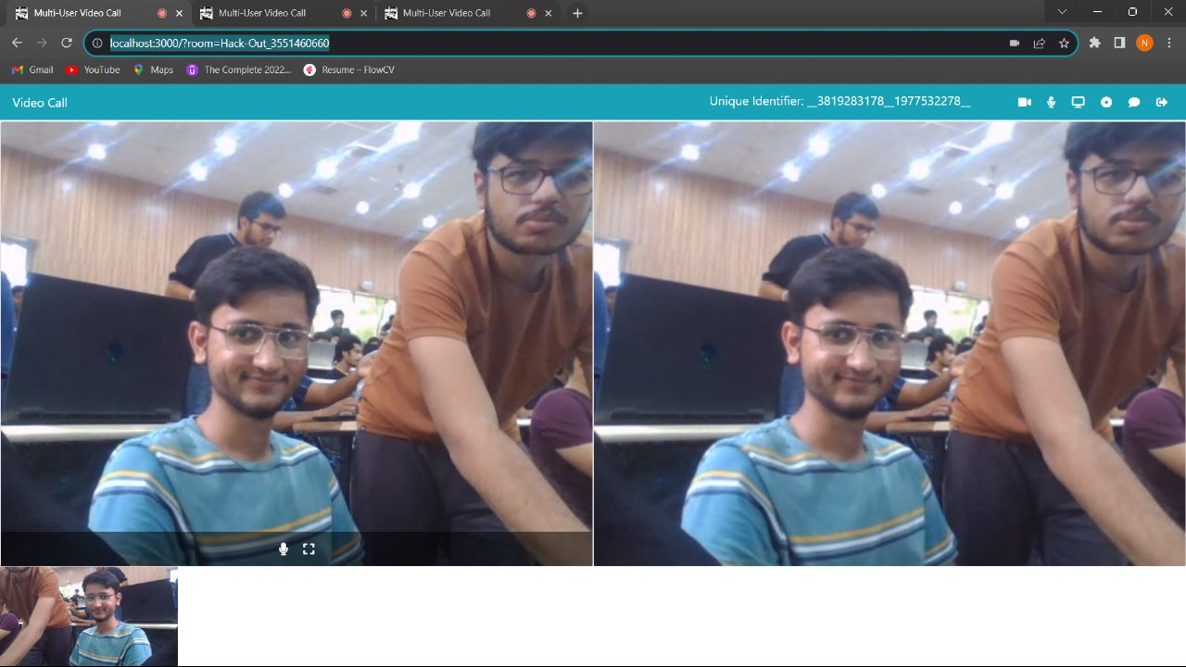
SCREENSHOTS

Slide 13
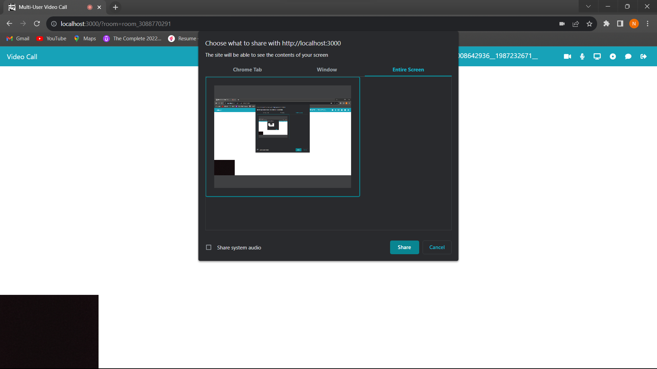

Slide 14
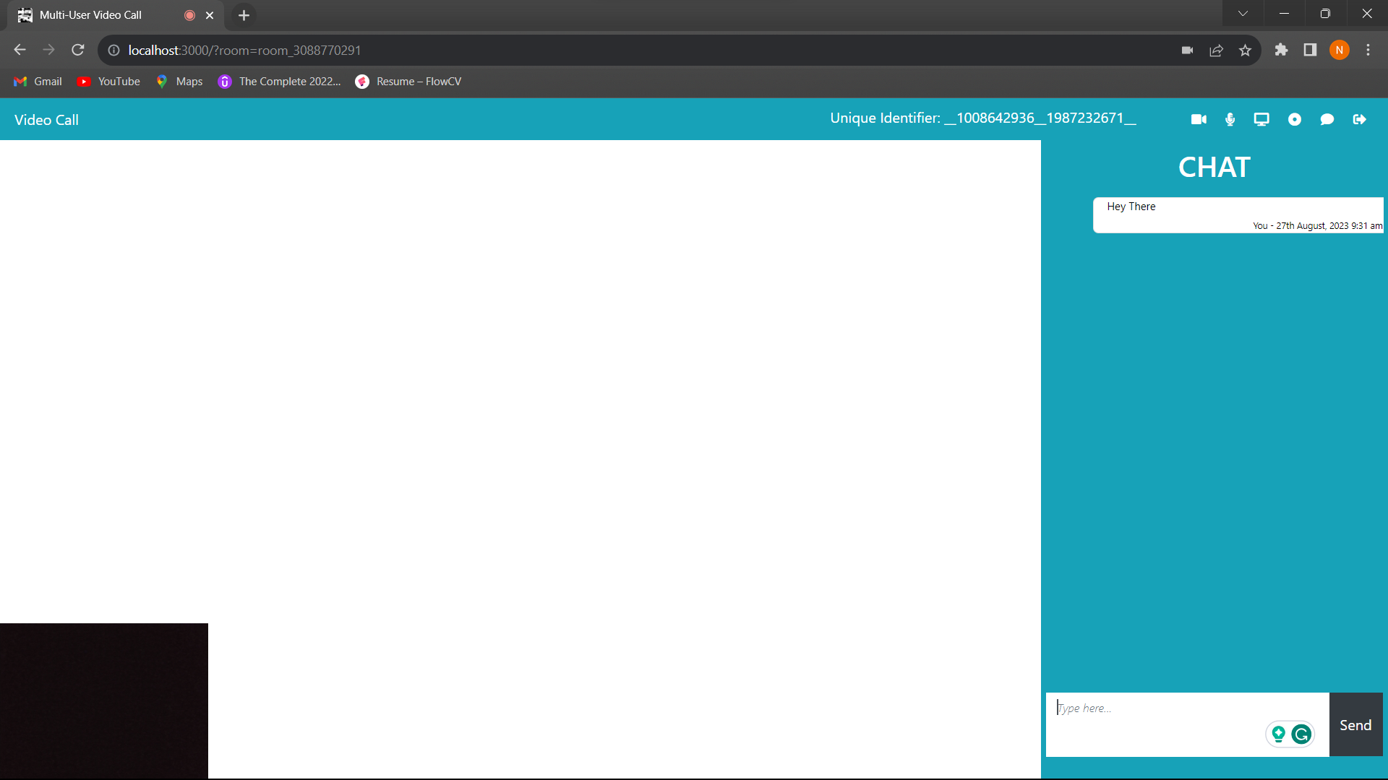

Slide 15
SOCIAL CAUSE
1) Virtual Swag Bags:
Instead of physical merchandise, include digital materials such as e-books, infographics, or documentaries that raise awareness about environmental issues, sustainable practices, and the importance of conservation.
Including resources like mindfulness apps, self-care tips, virtual fitness class or access to meditation sessions in virtual swag bags can contribute to participants' mental health.
Share resources on accessible design principles, assistive technologies, and organizations working to make technology more inclusive.
Include resources on volunteering opportunities, community service ideas, and ways to support local NGOs or charities.
2) Audience Engagement Games:
This can encourage participants to expand their knowledge and stay informed about relevant topics.
Interactive games can provide a fun and relaxing break from the content-heavy parts of conferences, promoting mental well-being by reducing stress and enhancing the overall experience.
Games focused on accessibility and tech inclusivity can raise awareness about the challenges faced by individuals with disabilities and promote the importance of creating inclusive digital experiences.

Slide 16
REAL WORLD IMPACT
Use-case scenarios:
A company can use this platform to host webinars for their employees to train them on new products or procedures. The games and quizzes can help to keep the employees engaged and make the training more interactive.
Educational Institutes can use this platform to host webinars for their students to learn about new research or to hear from guest speakers. The virtual swag bags can be used to reward students for participating in the webinars or for completing quizzes.
A non-profit organization can use this platform to host webinars to raise awareness about their cause or to recruit volunteers. The games and quizzes can help to engage the audience and make the webinar more fun.
Business models:
The platform can be free to use, with the option to purchase virtual swag bags or to upgrade to a premium plan that includes additional features.
The platform can charge a fee for each webinar that is hosted.
The platform can partner with businesses to offer sponsored webinars.

Slide 17
FUTURE SCOPES THAT CAN BE FURTHER ADDED
Audience Feedback Analytics: Collect and display real-time audience feedback and sentiment analysis to help presenters adjust their content accordingly.
Emotion Recognition: Implement AI-driven emotion recognition to gauge attendee reactions and adjust content or pacing accordingly.
Dynamic Event Polls: Conduct real-time polls and surveys throughout the event to gather attendee opinions and preferences, providing valuable insights.
Data Analytics and Reporting: Use Node.js to collect and analyze user data to generate insights and reports on attendee behavior and engagement during the event.

